Slide 1

ECE 448
Lab 3 – Part 1
FPGA Design Flow Based on
Xilinx Vivado and Vivado Simulator.
Using Seven-Segment Displays,
Buttons, and Switches.

Slide 2
Agenda for today
Part 1: Testing of FPGA boards
Part 2: Seven Segment Displays
Part 3: User Constraints File
Part 4: Buttons and Switches
Part 5: Introduction to FPGA Design Flow based on Xilinx Vivado and Vivado Simulator
Part 6: Introduction to Lab 3
Part 7: Class Exercise
Part 8: Demo Lab Assignment 2
Notes:
2

Slide 3
Part 1
Testing of FPGA Boards
Notes:
3

Slide 4
Part 2
Seven Segment Displays
Notes:
4

Slide 5
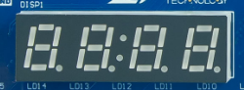
Seven Segment Displays
Notes:
5

Slide 6
4-Digit Seven Segment Display

Slide 7
Patterns for Decimal Digits

Slide 8
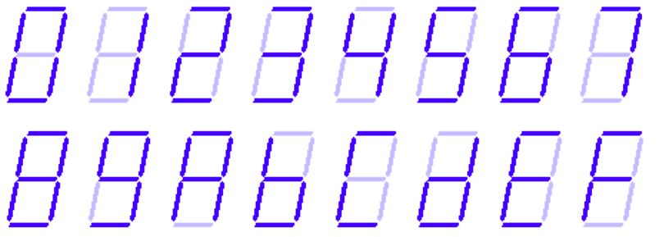
Patterns for Hexadecimal Digits

Slide 9
Connection to FPGA Pins

Slide 10
Multiplexing Digits

Slide 11
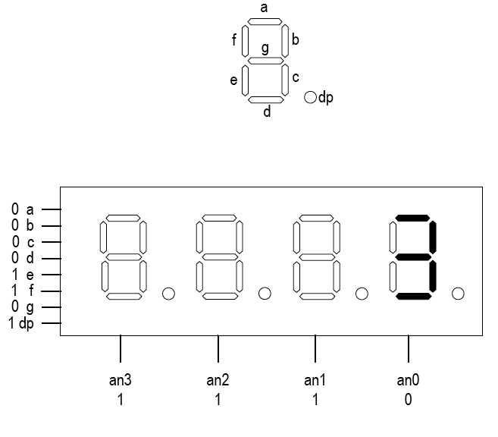
Time-Multiplexed Seven Segment Display

Slide 12
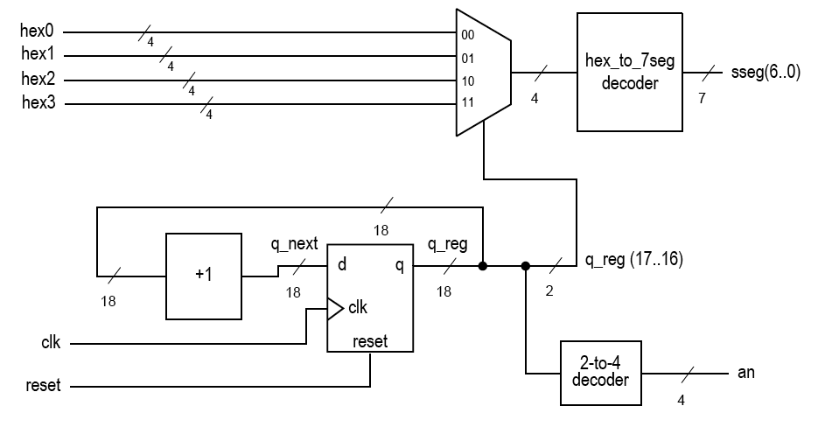
SSD_DRIVER
seg(6..0)
Counter UP
Counter UP
q(k-1..k-2)
Counter UP
COUNTER UP
Counter UP
clk
an
Counter UP
OC
rst
OC – One’s Complement

Slide 13
Size of the counter
1 ms ≤ 2^{k} * T_{CLK} ≤ 16 ms
f_{CLK} = 100 MHz
k = ?

Slide 14
Part 3
Xilinx Design Constraints (XDC)
Notes:
14

Slide 15
Xilinx Design Constraints (XDC)
File contains various constraints for Xilinx
Clock Period
Circuit Locations
Pin Locations
Every pin in the top-level unit needs to have a pin in the XDC

Slide 16
Basys 3
General
I/O Devices

Slide 17
BASYS 3 XDC – Seven Segment Display
#7 segment display
set_property PACKAGE_PIN W7 [get_ports {seg[0]}]
set_property IOSTANDARD LVCMOS33 [get_ports {seg[0]}]
set_property PACKAGE_PIN W6 [get_ports {seg[1]}]
set_property IOSTANDARD LVCMOS33 [get_ports {seg[1]}]
set_property PACKAGE_PIN U8 [get_ports {seg[2]}]
set_property IOSTANDARD LVCMOS33 [get_ports {seg[2]}]
set_property PACKAGE_PIN V8 [get_ports {seg[3]}]
set_property IOSTANDARD LVCMOS33 [get_ports {seg[3]}]
set_property PACKAGE_PIN U5 [get_ports {seg[4]}]
set_property IOSTANDARD LVCMOS33 [get_ports {seg[4]}]
set_property PACKAGE_PIN V5 [get_ports {seg[5]}]
set_property IOSTANDARD LVCMOS33 [get_ports {seg[5]}]
set_property PACKAGE_PIN U7 [get_ports {seg[6]}]
set_property IOSTANDARD LVCMOS33 [get_ports {seg[6]}]

Slide 18
BASYS 3 XDC – Seven Segment Display
#set_property PACKAGE_PIN V7 [get_ports dp]
#set_property IOSTANDARD LVCMOS33 [get_ports dp]
set_property PACKAGE_PIN U2 [get_ports {an[0]}]
set_property IOSTANDARD LVCMOS33 [get_ports {an[0]}]
set_property PACKAGE_PIN U4 [get_ports {an[1]}]
set_property IOSTANDARD LVCMOS33 [get_ports {an[1]}]
set_property PACKAGE_PIN V4 [get_ports {an[2]}]
set_property IOSTANDARD LVCMOS33 [get_ports {an[2]}]
set_property PACKAGE_PIN W4 [get_ports {an[3]}]
set_property IOSTANDARD LVCMOS33 [get_ports {an[3]}]

Slide 19
BASYS 3 XDC - LEDs
# LEDs
set_property PACKAGE_PIN U16 [get_ports {led[0]}]
set_property IOSTANDARD LVCMOS33 [get_ports {led[0]}]
set_property PACKAGE_PIN E19 [get_ports {led[1]}]
set_property IOSTANDARD LVCMOS33 [get_ports {led[1]}]
set_property PACKAGE_PIN U19 [get_ports {led[2]}]
set_property IOSTANDARD LVCMOS33 [get_ports {led[2]}]
set_property PACKAGE_PIN V19 [get_ports {led[3]}]
set_property IOSTANDARD LVCMOS33 [get_ports {led[3]}]
set_property PACKAGE_PIN W18 [get_ports {led[4]}]
set_property IOSTANDARD LVCMOS33 [get_ports {led[4]}]
set_property PACKAGE_PIN U15 [get_ports {led[5]}]
set_property IOSTANDARD LVCMOS33 [get_ports {led[5]}]

Slide 20
BASYS 3 XDC - LEDs
set_property PACKAGE_PIN U14 [get_ports {led[6]}]
set_property IOSTANDARD LVCMOS33 [get_ports {led[6]}]
set_property PACKAGE_PIN V14 [get_ports {led[7]}]
set_property IOSTANDARD LVCMOS33 [get_ports {led[7]}]
set_property PACKAGE_PIN V13 [get_ports {led[8]}]
set_property IOSTANDARD LVCMOS33 [get_ports {led[8]}]
set_property PACKAGE_PIN V3 [get_ports {led[9]}]
set_property IOSTANDARD LVCMOS33 [get_ports {led[9]}]
set_property PACKAGE_PIN W3 [get_ports {led[10]}]
set_property IOSTANDARD LVCMOS33 [get_ports {led[10]}]
set_property PACKAGE_PIN U3 [get_ports {led[11]}]
set_property IOSTANDARD LVCMOS33 [get_ports {led[11]}]
set_property PACKAGE_PIN P3 [get_ports {led[12]}]
set_property IOSTANDARD LVCMOS33 [get_ports {led[12]}]

Slide 21
BASYS 3 XDC - LEDs
set_property PACKAGE_PIN N3 [get_ports {led[13]}]
set_property IOSTANDARD LVCMOS33 [get_ports {led[13]}]
set_property PACKAGE_PIN P1 [get_ports {led[14]}]
set_property IOSTANDARD LVCMOS33 [get_ports {led[14]}]
set_property PACKAGE_PIN L1 [get_ports {led[15]}]
set_property IOSTANDARD LVCMOS33 [get_ports {led[15]}]

Slide 22
BASYS 3 XDC CLOCK
# Clock signal
set_property PACKAGE_PIN W5 [get_ports clk]
set_property IOSTANDARD LVCMOS33 [get_ports clk]
create_clock -add -name sys_clk_pin -period 10.00 -waveform {0 5} [get_ports clk]

Slide 23
Part 4
Switches and Buttons
Notes:
23

Slide 24
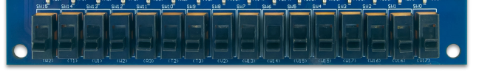

Slide 25
Basys 3
Slide Switches

Slide 26
BASYS 3 XDC – Switches
# Switches
set_property PACKAGE_PIN V17 [get_ports {sw[0]}]
set_property IOSTANDARD LVCMOS33 [get_ports{sw[0]}]
set_property PACKAGE_PIN V16 [get_ports {sw[1]}] set_property IOSTANDARD LVCMOS33 [get_ports {sw[1]}]
set_property PACKAGE_PIN W16 [get_ports {sw[2]}] set_property IOSTANDARD LVCMOS33 [get_ports {sw[2]}]
set_property PACKAGE_PIN W17 [get_ports {sw[3]}] set_property IOSTANDARD LVCMOS33 [get_ports {sw[3]}]
set_property PACKAGE_PIN W15 [get_ports {sw[4]}] set_property IOSTANDARD LVCMOS33 [get_ports {sw[4]}]
set_property PACKAGE_PIN V15 [get_ports {sw[5]}] set_property IOSTANDARD LVCMOS33 [get_ports {sw[5]}]
set_property PACKAGE_PIN W14 [get_ports {sw[6]}] set_property IOSTANDARD LVCMOS33 [get_ports {sw[6]}]
set_property PACKAGE_PIN W13 [get_ports {sw[7]}] set_property IOSTANDARD LVCMOS33 [get_ports {sw[7]}]

Slide 27
BASYS 3 XDC – Switches (2)
set_property PACKAGE_PIN V2 [get_ports {sw[8]}]
set_property IOSTANDARD LVCMOS33 [get_ports {sw[8]}]
set_property PACKAGE_PIN T3 [get_ports {sw[9]}] set_property IOSTANDARD LVCMOS33 [get_ports {sw[9]}]
set_property PACKAGE_PIN T2 [get_ports {sw[10]}] set_property IOSTANDARD LVCMOS33 [get_ports {sw[10]}]
set_property PACKAGE_PIN R3 [get_ports {sw[11]}] set_property IOSTANDARD LVCMOS33 [get_ports {sw[11]}]
set_property PACKAGE_PIN W2 [get_ports {sw[12]}] set_property IOSTANDARD LVCMOS33 [get_ports {sw[12]}]
set_property PACKAGE_PIN U1 [get_ports {sw[13]}] set_property IOSTANDARD LVCMOS33 [get_ports {sw[13]}]
set_property PACKAGE_PIN T1 [get_ports {sw[14]}] set_property IOSTANDARD LVCMOS33 [get_ports {sw[14]}]
set_property PACKAGE_PIN R2 [get_ports {sw[15]}] set_property IOSTANDARD LVCMOS33 [get_ports {sw[15]}]

Slide 28
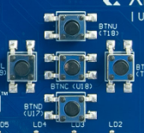
Buttons
Notes:
28

Slide 29
Connection of Buttons to FPGA Pins

Slide 30
Debouncing Buttons
key bounce, t_{BOUNCE}
key bounce, t_{BOUNCE}
Bouncing period typically smaller than 10 ms

Slide 31
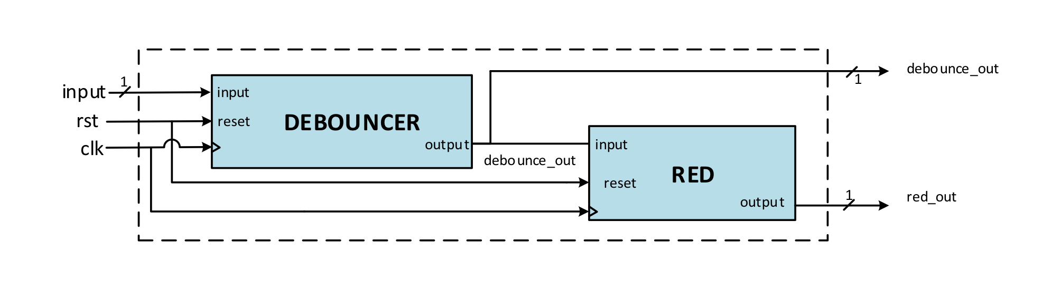
Using DEBOUNCE_RED
to Generate Short Pulses (1)
RED – Rising Edge Detector

Slide 32
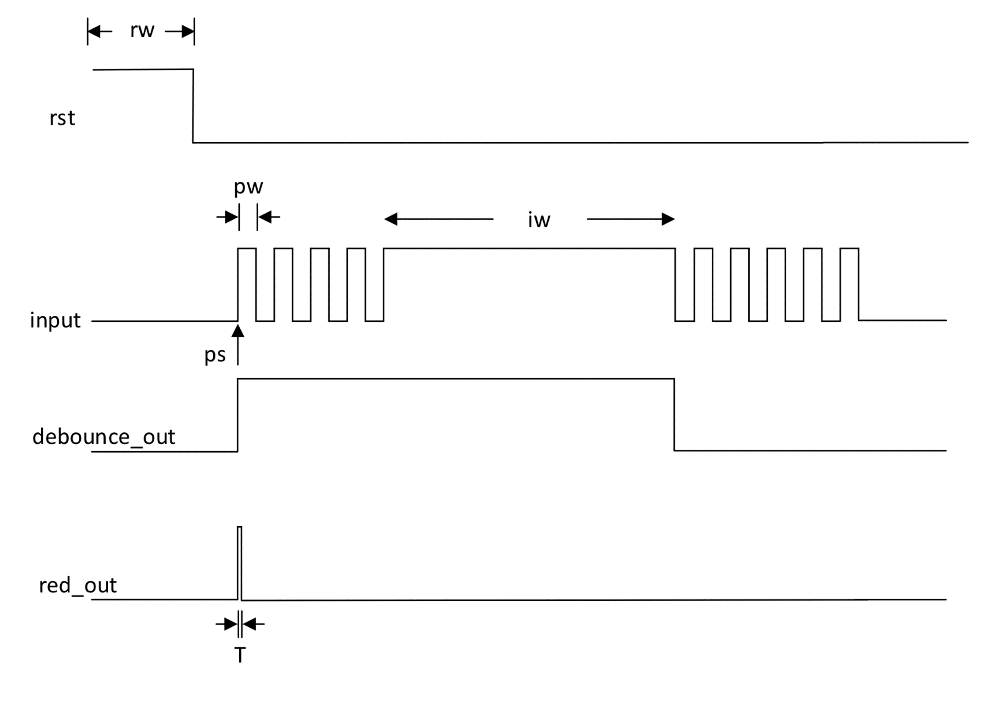
Using DEBOUNCE_RED
to Generate Short Pulses (2)

Slide 33
Debouncer
reset
Debouncer
output
input
clk

Slide 34
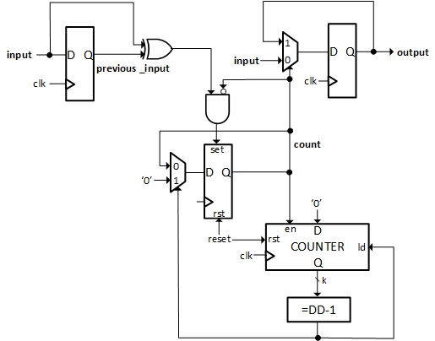
Debouncer

Slide 35
k and DD Generics
k - width of the counter used to measure the debouncing period
DD - debouncing period in clock cycles
Values of generics given on the next slide assume that the
clock frequency = 100 MHz
and thus
clock period = 10 ns.

Slide 36
k and DD Generics
Option 1 (value used for simulation only):
DD = 100
assuming bouncing period < 1 μs = 1000 ns
condition: DD*10ns = 1000 ns => DD = 100
k=7 because 2^7 > 100
Option 2 (values used for synthesis, implementation,
and experimental testing):
DD = 1000000
assuming bouncing period = 10 ms
condition: DD*10ns = 10ms => DD = 1,000,000
k=20 because 2^20 > 1,000,000

Slide 37
Rising Edge Detector - RED
Rising Edge Detector
Turn a step function into an impulse
Allows a step to run a circuit for only one clock cycle

Slide 38
Rising Edge Detector
reset
rising edge detector
input
q
output
clk
clk
input
q
output

Slide 39
Connection of Buttons to FPGA Pins

Slide 40
BASYS 3 XDC – Buttons
#Buttons
set_property PACKAGE_PIN U18 [get_ports btnC]
set_property IOSTANDARD LVCMOS33 [get_ports btnC]
set_property PACKAGE_PIN T18 [get_ports btnU]
set_property IOSTANDARD LVCMOS33 [get_ports btnU]
set_property PACKAGE_PIN W19 [get_ports btnL]
set_property IOSTANDARD LVCMOS33 [get_ports btnL]
set_property PACKAGE_PIN T17 [get_ports btnR]
set_property IOSTANDARD LVCMOS33 [get_ports btnR]
set_property PACKAGE_PIN U17 [get_ports btnD]
set_property IOSTANDARD LVCMOS33 [get_ports btnD]

Slide 41
Part 5
Hands-on Session on
FPGA Design Flow
based on Xilinx Vivado
and Vivado Simulator
Notes:
41

Slide 42
Part 6
Introduction to Lab 3
The Simon Game
Notes:
42

Slide 43
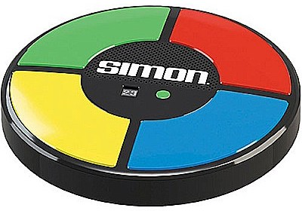
Simon
An electronic game designed to test your memory.
The device creates a sequence of light patterns
and requires a user to repeat the sequence by
pressing the corresponding buttons.
If the user succeeds, the series becomes progressively
longer and more complex.
Once the user fails the game is over.

Slide 44
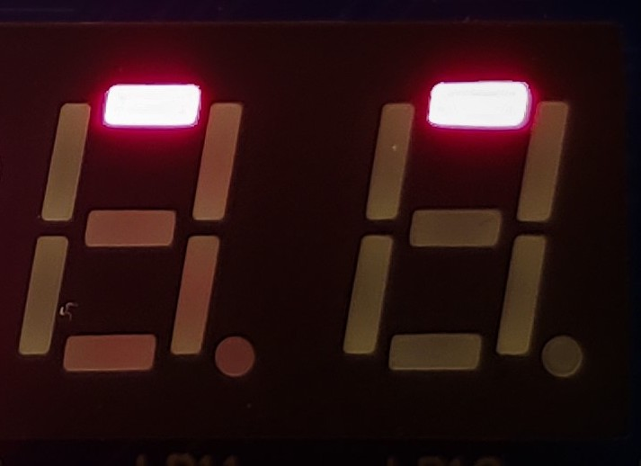
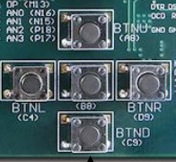
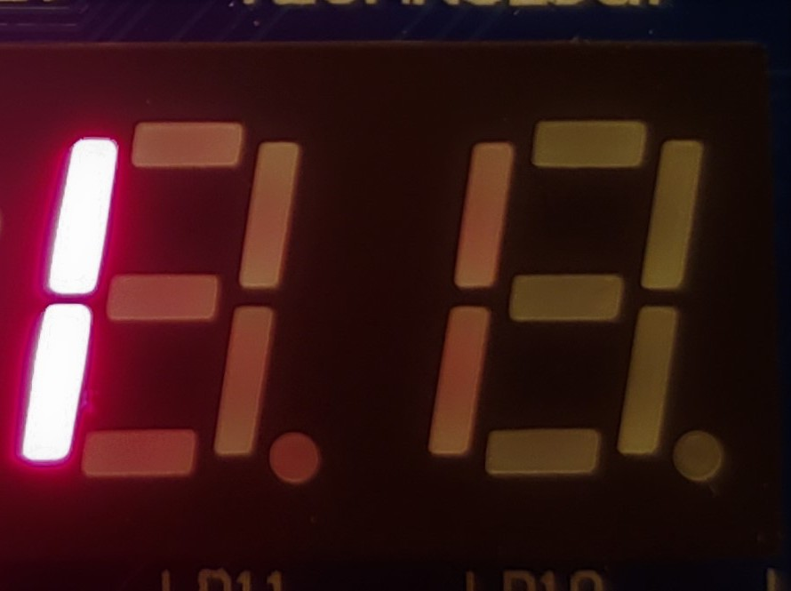
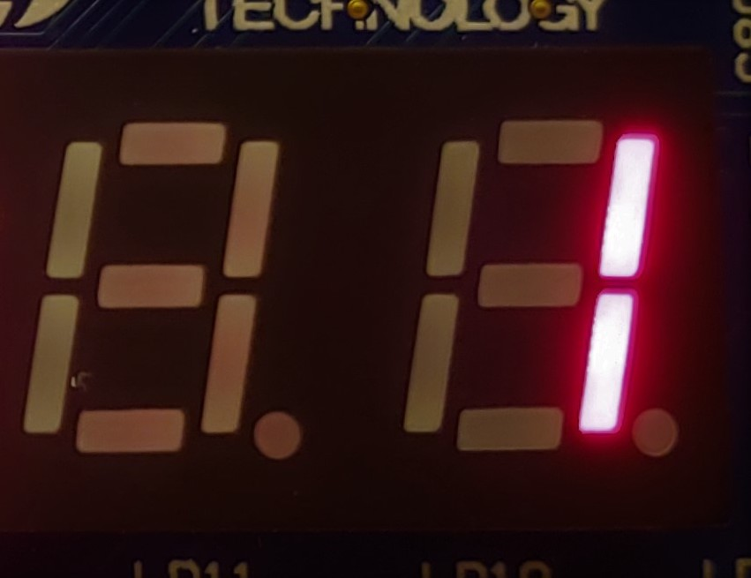
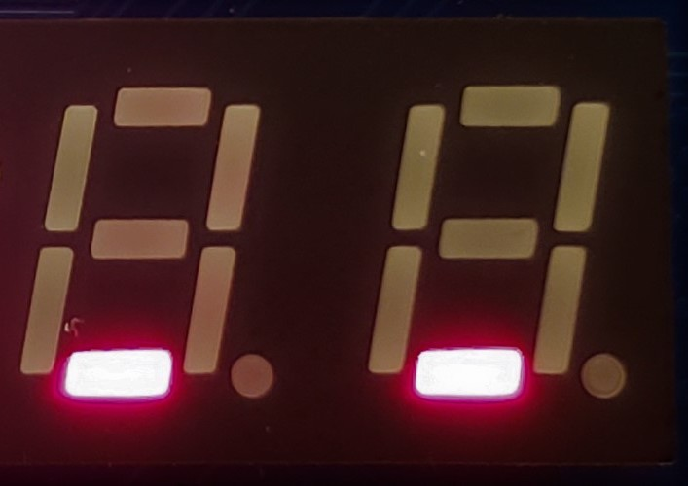
Implementation Using Basys 3
Four Patterns & Four Corresponding Buttons
UP
BTNU
(UP)
LEFT
RIGHT
BTNL
(LEFT)
BTNR
(RIGHT)
BTND
(DOWN)
DOWN
Two rightmost 7-segment displays

Slide 45
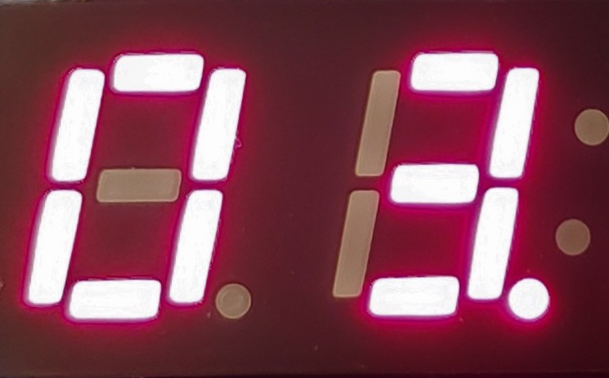
Current Level
The level determines
the number of
patterns in a sequence.
The initial level is equal to 1.
When a user properly repeats
the displayed sequence using
buttons, the level is incremented.
Two leftmost
7-segment displays
If the user succeeds at the level 16,
the game is over.

Slide 46
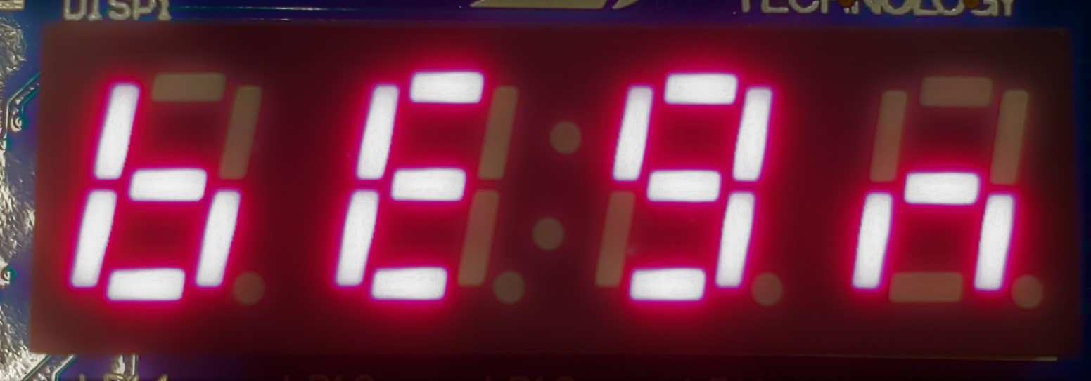
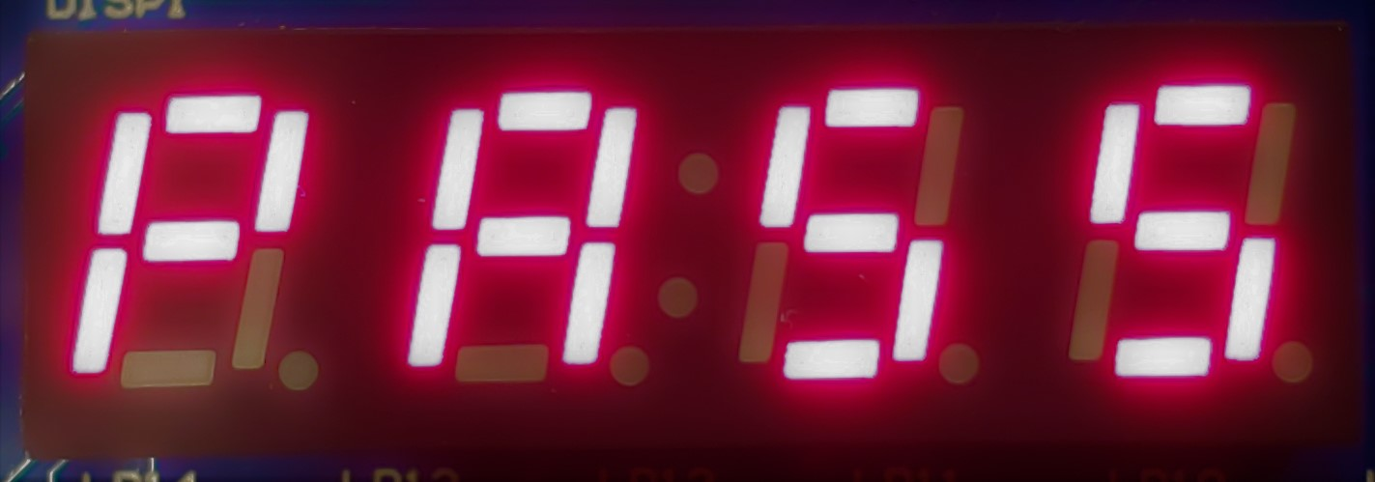
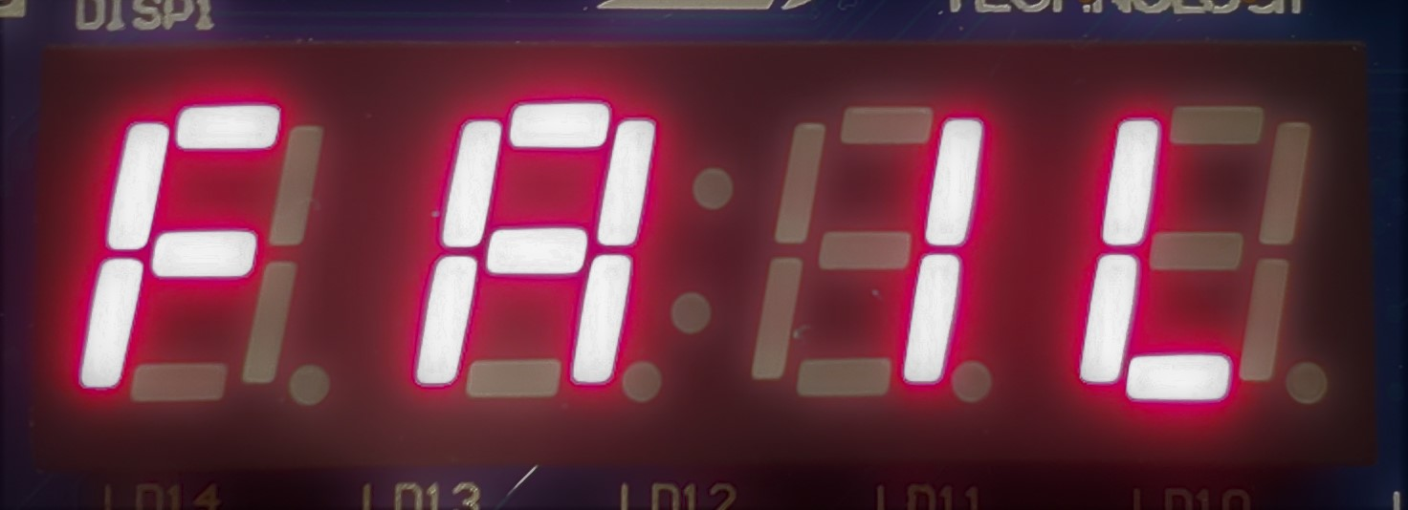
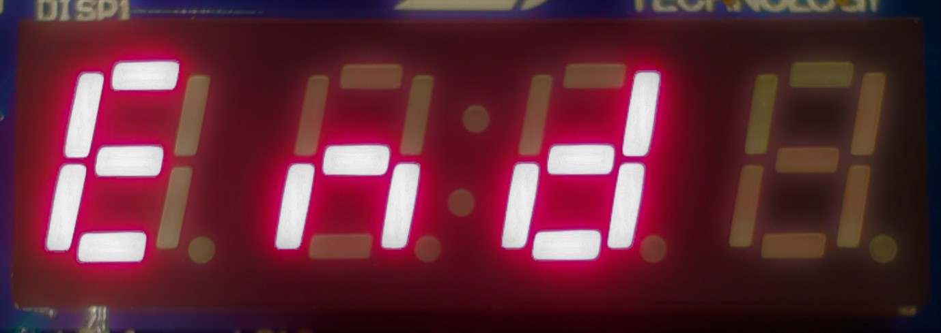
Additional Messages
Begin (bEgn): Blinking. Displayed in the reset state until BTNC is pressed.
PASS: Static. Displayed for 2 seconds
after a user clears a level.
FAIL: Static. Displayed for 2 seconds
after a user fails to clear a level.
End: Blinking. Displayed for 2 seconds
after the game is over.

Slide 47
Controls the delay between the patterns displayed
during the game.
Difficulty Level
Controls the delay between the patterns displayed during a game.
Should be set before the start of a game
and should stay the same throughout the game.
Controlled by two leftmost switches: SW 15 & 14
0 0: delay of 2.0 seconds
0 1: delay of 1.5 seconds
1 0: delay of 1.0 seconds
1 1: delay of 0.5 seconds

Slide 48
Pseudo-Random Number Generators
Implemented Using LFSRs
Notes:
48

Slide 49
PRNG
Generates a sequence of numbers that approximates the properties of random numbers.
The sequence is fully deterministic, i.e., it can
be repeated based on an initial state of PRNG.
The period of the sequence may be made very large (typically, 2^{n}-1, where n is an internal state size)

Slide 50
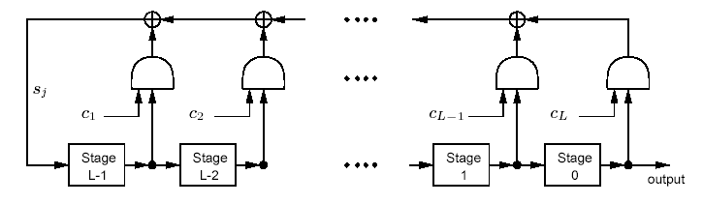
Linear Feedback Shift Register (LFSR)
Each stage = D flip-flop
⟨ L, C(D) ⟩
Length
Connection polynomial, C(D)
C(D) = 1 + c₁D + c₂D² + . . . + c_{L}D^{L}

Slide 51
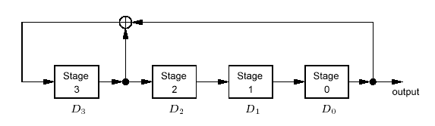
Example of LFSR
⟨ 4, 1+D+D⁴⟩
Length
Connection polynomial, C(D)
C(D) = 1 + 1⋅D + 0⋅D² + 0⋅D³ + 1⋅D⁴
c₁=1
c₂=0
c₃=0
c₄=1

Slide 52
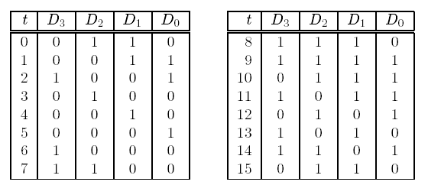
LFSR State Sequence
s₄
s₃
s₂
s₁
s₀
s₄ = c₁s₃ ⊕ c₂s₂ ⊕ c₃s₁ ⊕ c₄s₀ = s₃ ⊕ s₀

Slide 53
LFSR to be used in Lab 3
⟨ 8, 1+D⁴+D⁵+D⁶+D⁸⟩
Length
Connection polynomial, C(D)
Selected to make a period = 2⁸-1 = 255

Slide 54
Using LFSR to Generate Patterns
Two least significant bits at the output of LFSR, s₁ & s₀,
determine a pattern:
s₁ s₀
0 0 UP
0 1 RIGHT
1 0 LEFT
1 1 DOWN
After one pattern is generated,
LFSR is shifted by two positions.

Slide 55
Initialization of LFSR
Before the generation of each sequence, LFSR is initialized
with the values determined by the positions of switches SW 7..0
These positions should be set before the start of a game
and should stay the same throughout the game.
The initial state composed of all zeros is not permitted.

Slide 56
Button Debounce
Each button used in the game must have an associated
debouncing circuit to ensure the accurate reading
of the user input

Slide 57
Bonus Task: Reset
If BTNC is pressed for more
than 2 seconds, then the game
should be stopped and enter
the reset state.

Slide 58
Tasks
Draw a block diagram describing the required Datapath.
Draw Algorithmic State Machine (ASM) charts describing
the required Controller.
3. Translate the block diagram and ASM charts to VHDL.
4. Develop a testbench with two versions of timing constants,
one used for simulation, and the other used for the actual operation
of the circuit on the board.
5. Perform functional simulation of your code (up to the Simon level 4).
6. Synthesize your code using Xilinx Vivado.
7. Prepare the correct XDC (Xilinx Design Constraint) file.
8. Implement your circuit using Xilinx Vivado.
9. Check thoroughly all implementation reports.
10. Perform post-synthesis simulation of your circuit using ModelSim
or Vivado Simulator.
11. Perform static timing analysis.
12. Check very carefully your pin allocations listed in the report files,
and only if these pin allocations are correct, download your bitstream
to the FPGA board.
13. Test the operation of your circuit experimentally using the Basys 3
FPGA Board.

Slide 59
Deliverables
All block diagrams and ASM charts.
All source files used for synthesis and implementation of your circuit.
Testbench.
User constraint files.
All synthesis and implementation report files.
RTL netlist.
Simulation waveforms from the functional and post-synthesis
simulations, proving the correct operation of your circuit
(in the PDF format).
8. Report file from the static timing analysis.
9. Your own report containing at least the following additional information:
Resource utilization.
Minimum clock period and maximum clock frequency after
synthesis and after implementation.
List of any deviations from the original specification.
Difficulties encountered and lessons learned.

Slide 60
Part 7
Lab Exercise
Notes:
60

Slide 61
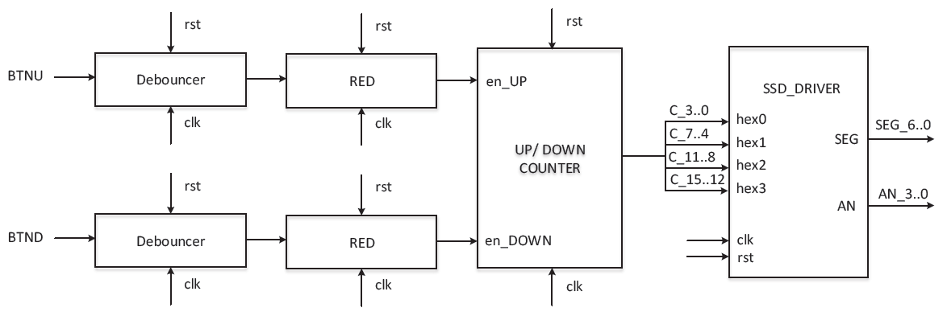
16-bit Binary Up-Down Counter

Slide 62
SSD_DRIVER
SEG(6..0)
Counter UP
Counter UP
q(k-1..k-2)
Counter UP
COUNTER UP
Counter UP
clk
AN
Counter UP
OC
rst
OC – One’s Complement

Slide 63
Lab Assignment 2: Demo
Part 8

